Slide 1
AI Today – Optimisation
Introduction to Machine Learning Computer Science BSc Course, ELTE Faculty of Informatics
László Gulyás
Associate Professor Department of Artificial Intelligence lgulyas@inf.elte.hu

Slide 2
What is AI?
AI = Optimisation

Slide 3

What is AI?
$$f^{∗}=\max_{x∈X} f(x)$$

Slide 4

What is AI?
$$f^{∗}={argmax}_{x∈X} f(x)$$

Slide 5

What is AI?
$$f^{∗}={argmin}_{x∈X} f(x)$$

Slide 6

What is AI?
$$f^{∗}={argmin}_{w∈W} f(w, x)$$
w – Learned parameters
x -- Input instances of the task (images to be recognized, etc.)

Slide 7
Intelligence = Optimisation??

Slide 8
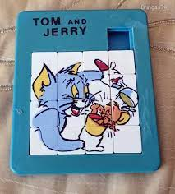
Intelligent Behavior: Problem Solving
Shortest Path from A to B
Fewest steps, shortest path, shortest time…
C.f., navigation
Solve the 15 stone puzzle
Fewest number of moves
Generally, find the moves that yields the highest score

Slide 9
Intelligent Behavior: Planning
In what order shall moves be made?
To achieve the most...
To gain the highest combined benefit…
Example: scheduling factory production
Incoming series of orders (various products, batch sizes)
Different tooling requirements
Varying unit production time
→
Minimize time lost on switching between products

Slide 10
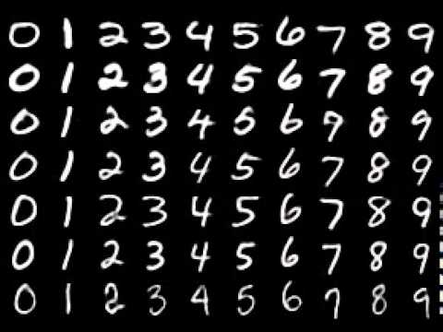
Intelligent Behavior: Recognising Images, Voices, Text
Error (loss):
E.g., in what percent of the cases did it err?
Goal to minimize
I.e., increase accuracy

Slide 11

Intelligent Behavior: Learning
The Key
Improvement
Example:
Aim at target
Assess Results
Change → Get better
Again
Minimize error
Maximize accuracy

Slide 12
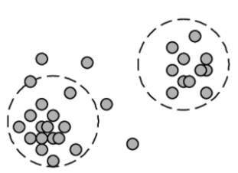
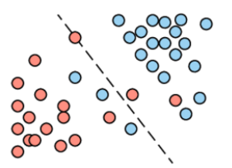
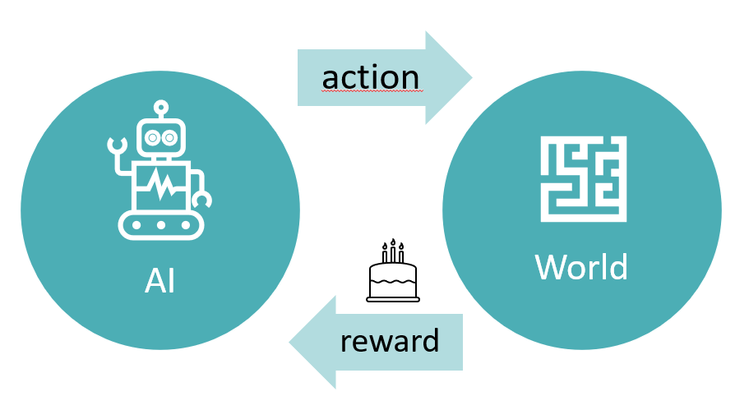
Machine Learning See upcoming lectures
Unsupervised learning
Raw data
Supervised learning
Training data (with labels)
Reinforcement learning
No data, but observable outcomes

Slide 13
Remark
Learning is usually a slow process
Large amounts of data is required
Many training examples need to be seen
Many games should be played (cf. Practice, Sports training)
Humans also learn for decades
Basic skills – first few years
Elementary knowledge – about 12 years
Professional knowledge – 3+2 years (BSc + MSc)
To get a junior position (read: unexperienced)
It never really stops

Slide 14
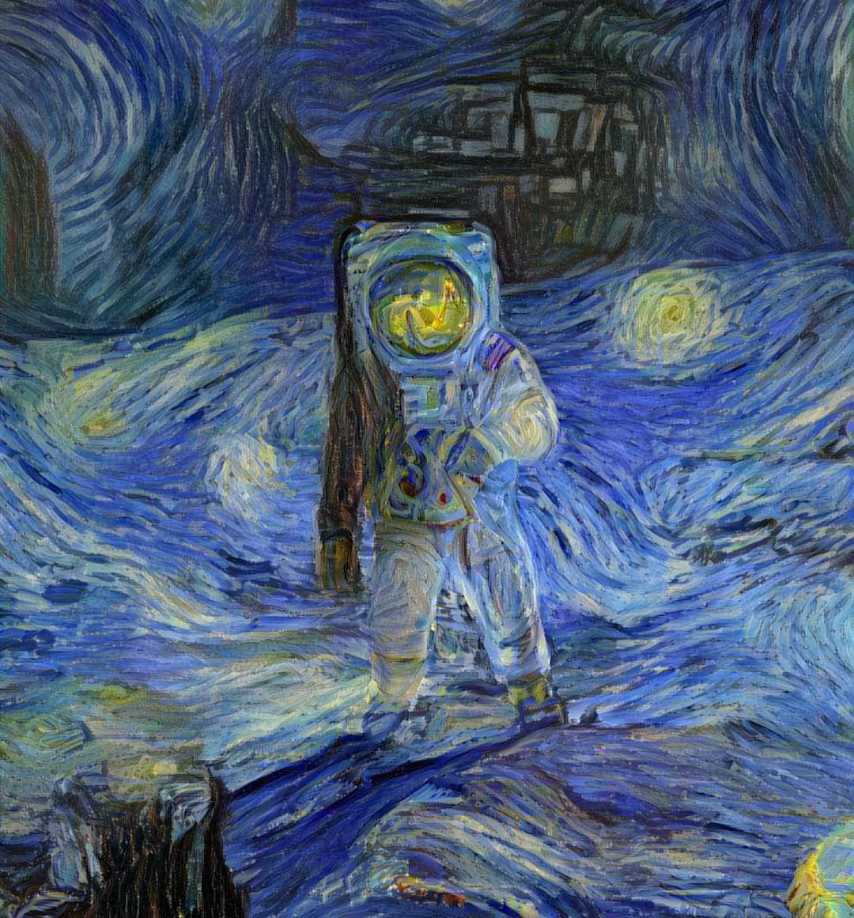
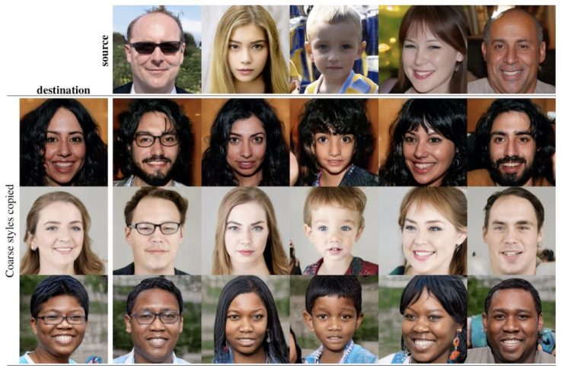
Intelligent Behavior: Generating Something New
Synthetic images produced by StyleGAN, a GAN created by Nvidia researchers.
© Night Café Studio
Synthetic images produced by StyleGAN, a GAN created by Nvidia researchers.

Slide 15
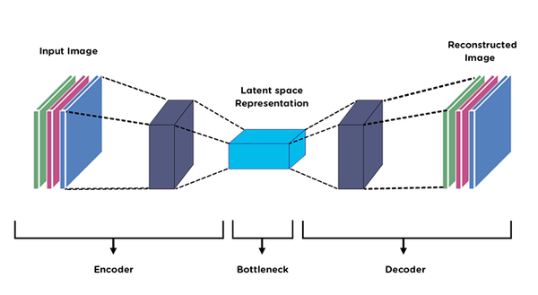
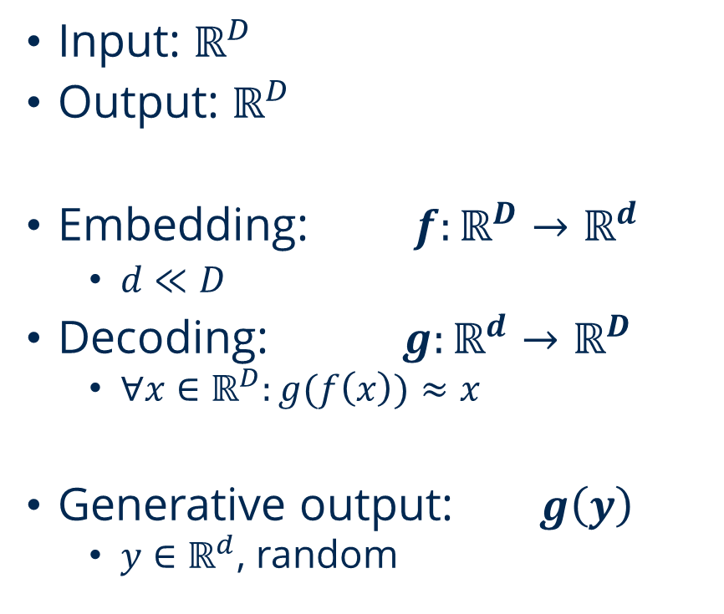
Autoencoders An abstract approach
Input: $ℝ^{D}$
Output: $ℝ^{D}$
Embedding: ${f:ℝ}^{D}→ℝ^{d}$
$d≪D$
Decoding: ${g:ℝ}^{d}→ℝ^{D}$
$∀x∈ℝ^{D}:g(f\left(x\right))≈x$
Generative output: $g\left(y\right)$
$y∈ℝ^{d}$, random

Slide 16
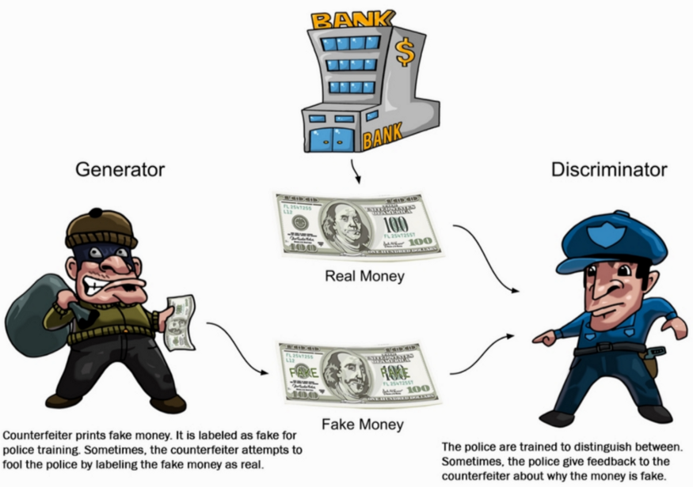
Intelligent Behavior: Generating Something New
Generative Adversarial Network (GAN)
First widely successful generative solution
Bandit vs Cops game
‚Generative duel’
They both learn (optimise)
After a while, the output of the bandit is new creation
©Prajwol Lamichhane
Synthetic images produced by StyleGAN, a GAN created by Nvidia researchers.

Slide 17
What is hard in optimisation?
OK, AI is optimisation, but…

Slide 18

AI = Optimisation What is hard in this?
$$f^{∗}={argmin}_{w∈W} f\left(w, x\right)$$

Slide 19
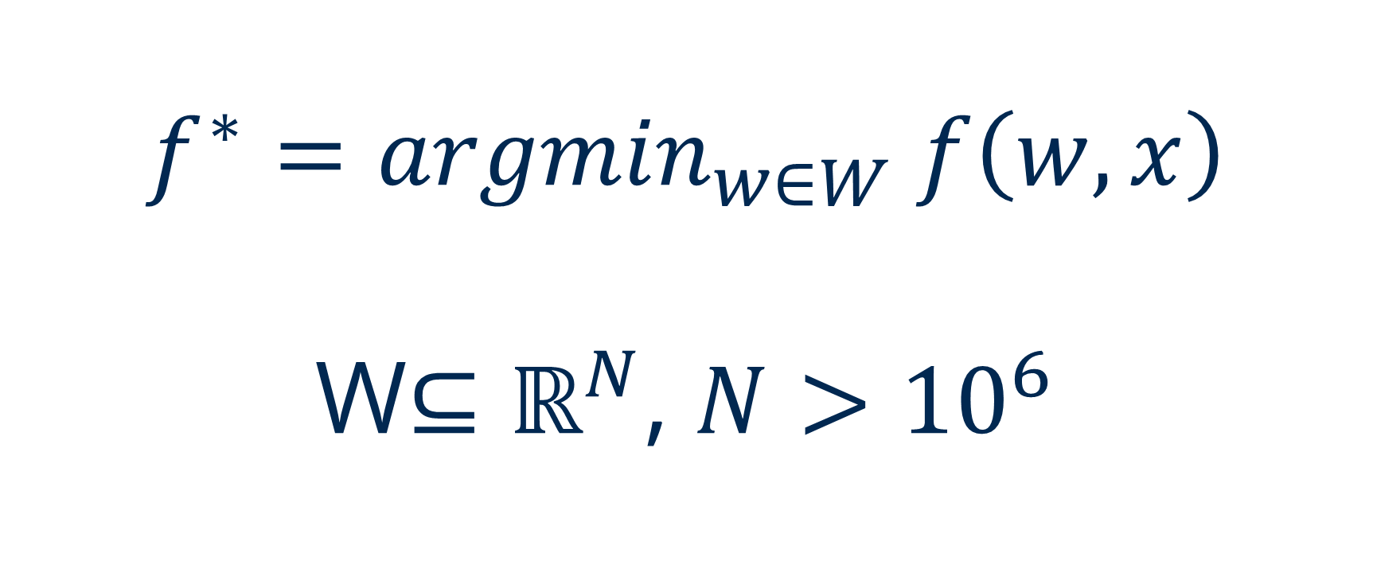
AI = Optimisation What is hard in this? Dimensionality
$$f^{∗}={argmin}_{w∈W} f\left(w,x\right)$$
W$⊆ℝ^{N}$, $N>{10}^{6}$

Slide 20
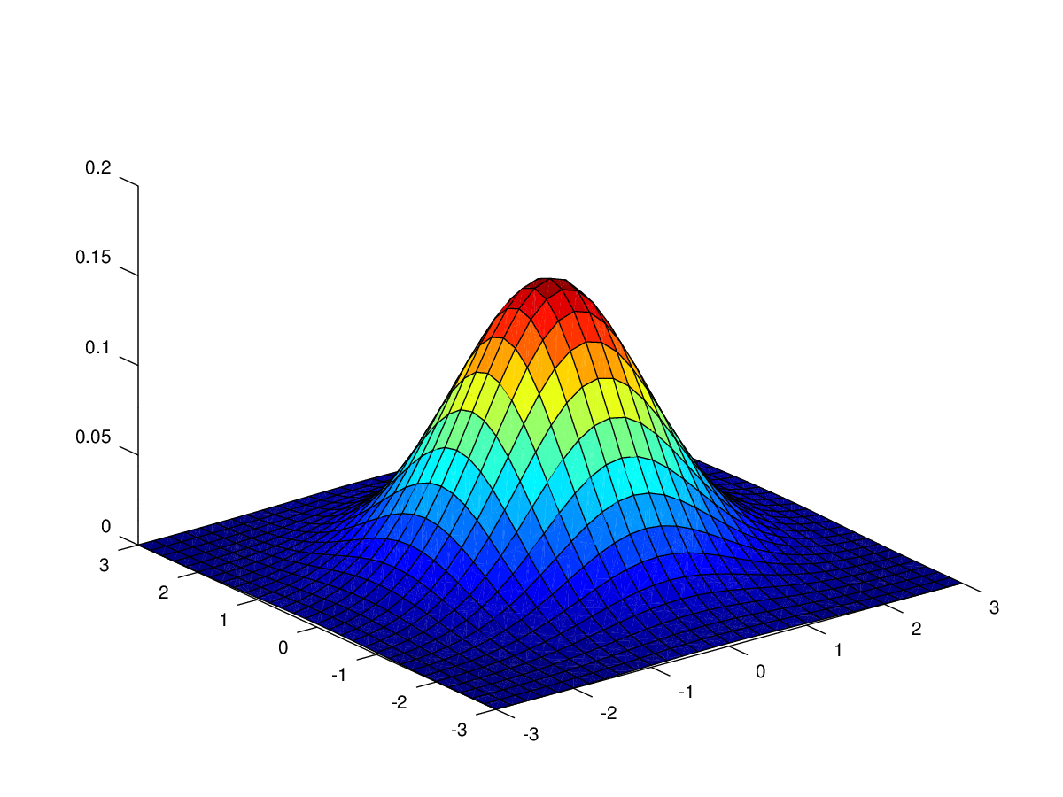
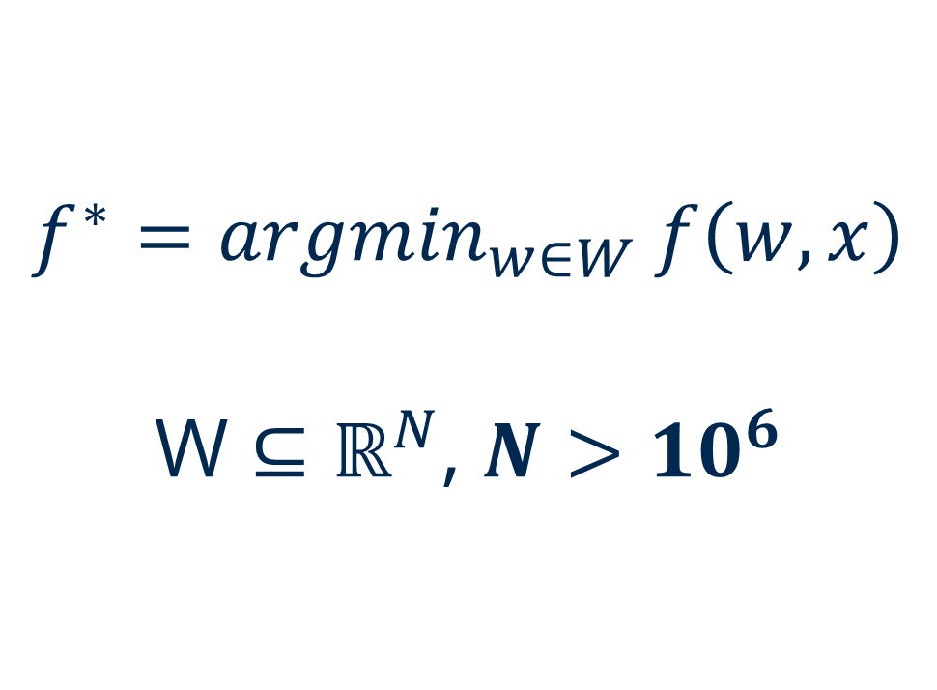
AI = Optimisation What is hard in this?
$$f^{∗}={argmin}_{w∈W} f\left(w,x\right)$$
W $⊆ℝ^{N}$, $N>{10}^{6}$

Slide 21
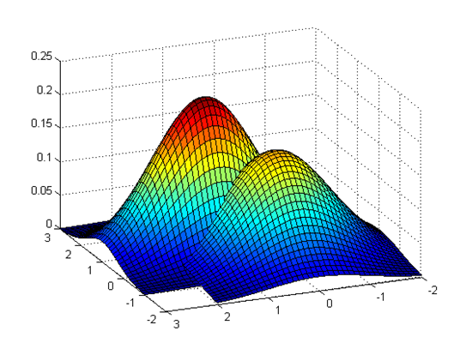
AI = Optimisation What is hard in this? Non-monotonicity
$$f^{∗}={argmin}_{w∈W} f\left(w,x\right)$$
W $⊆ℝ^{N}$, $N>{10}^{6}$

Slide 22
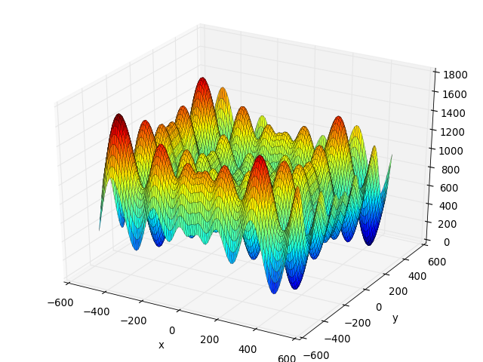
AI = Optimisation What is hard in this? Ruggedness
$$f^{∗}={argmin}_{w∈W} f\left(w,x\right)$$
W $⊆ℝ^{N}$, $N>{10}^{6}$

Slide 23
This is a hard problem – No known general solution
$$f^{∗}={argmin}_{w∈W} f\left(w,x\right)$$
W $⊆ℝ^{N}$, $N>{10}^{6}$

Slide 24
Inspirations
Borrowing from where it works...

Slide 25
Biologically Inspired Methods –
Brain
Evolution
Social Insects
Artificial Neural Networks
Evolutionary Algorithms
Swarm Intelligence Methods

Slide 26
Thank you!
László Gulyás
Associate Professor Department of Artificial Intelligence lgulyas@inf.elte.hu

